Slide 1

GUI Automation USING OPEN CV
A sketch tool that helps to create a skeleton of a Website or an APP.
CSE-6324-001 TEAM 1
Harsh Chaludia and Deep Patel.
GitHub repository: ShapeReceipe

Slide 2

OPEN CV
We load the image file with a resized factor typically smaller, to outline the shapes with a good estimation.
We grab the contours, and finally initialize the shape detector.py, and label the images.
Next, we grayscale the image, to find contours.
SHAPE DETECTION METHOD
We create a JSON object with shapes, and dump it on PHP page, or a server to decode it with an array.
After getting the json object we generate a website, or a react native app which renders the app both on ios as well as android.
Map each object with skeleton elements like header, footer, cards, slider etc.

Slide 3
Features
Doodle sketch pad to draw the shapes, and user can sketch a design on a piece of paper with shapes.
Mapping shape to associated code.
Options to get code for Website, React Native Application(Android App/IOS App).
Preview link to demo before finalize the application.
A separate page for manual of drawing elements.

Slide 4
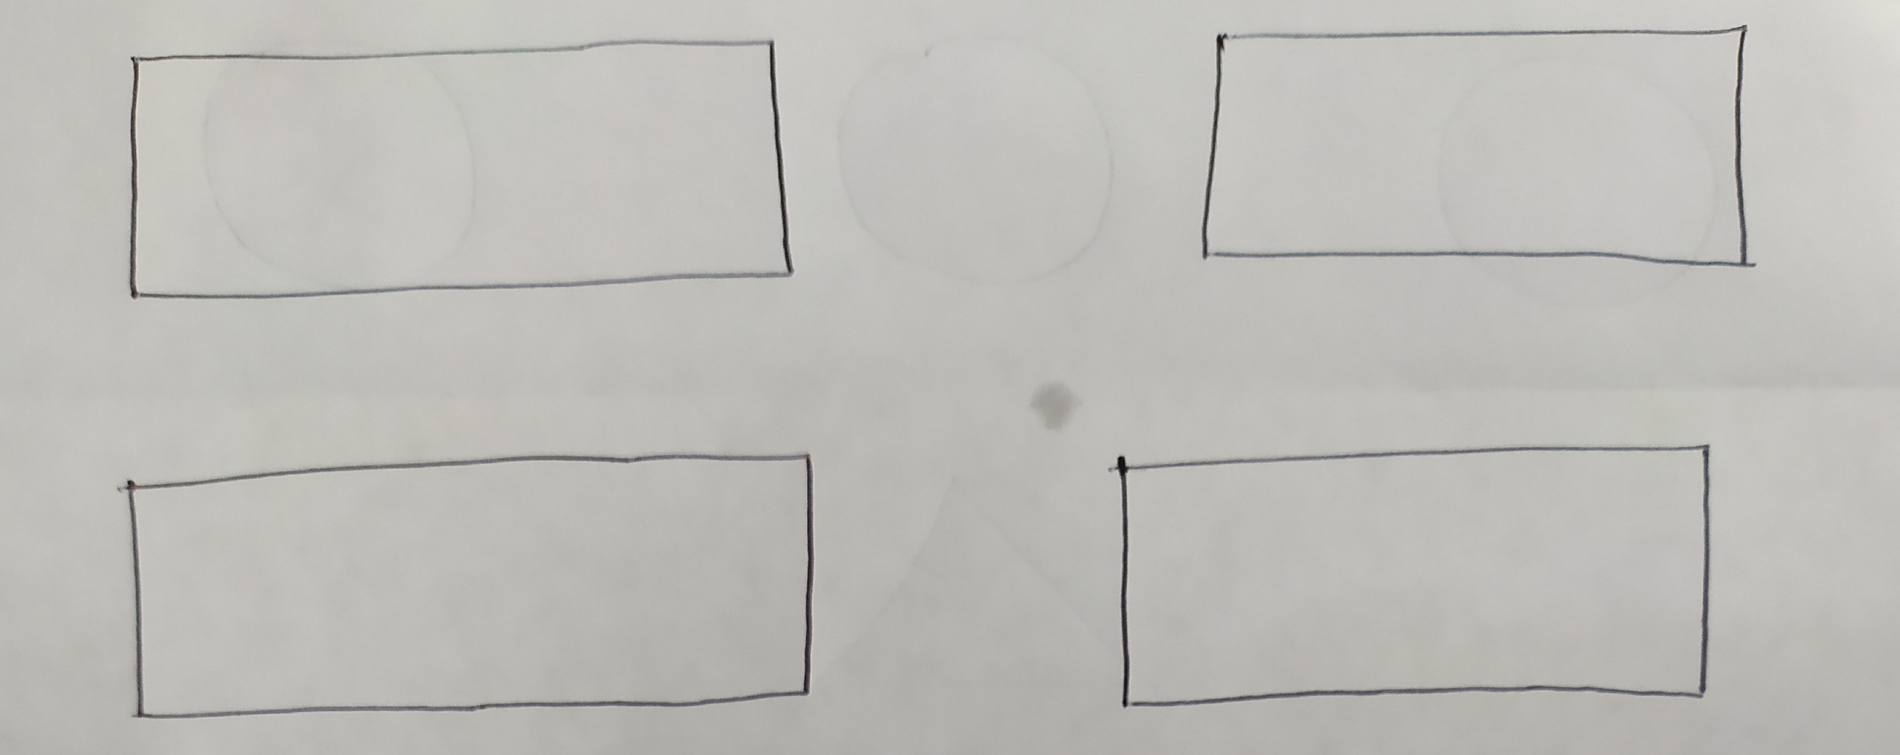
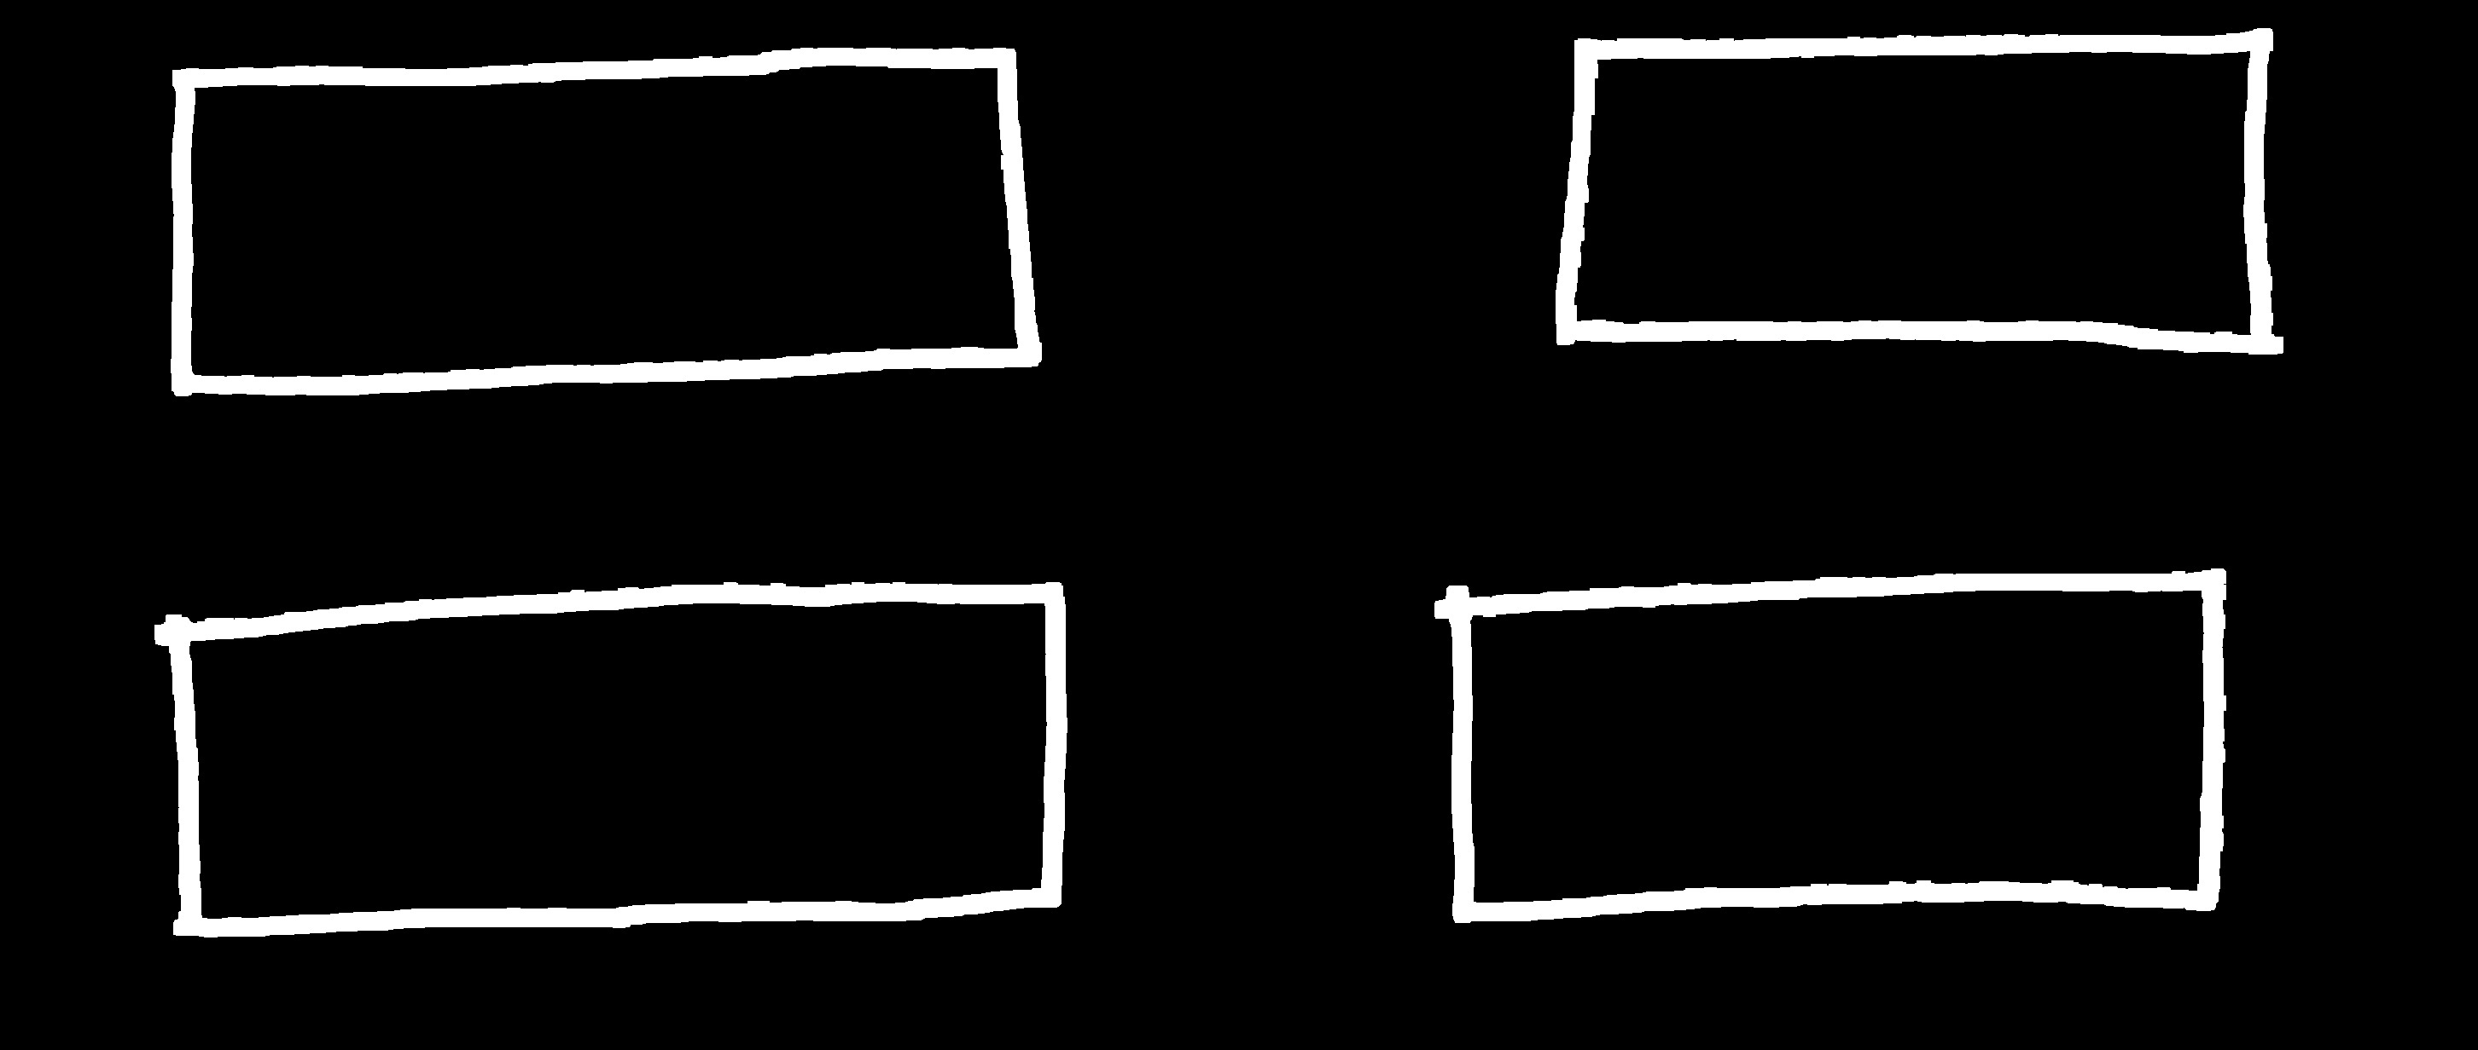
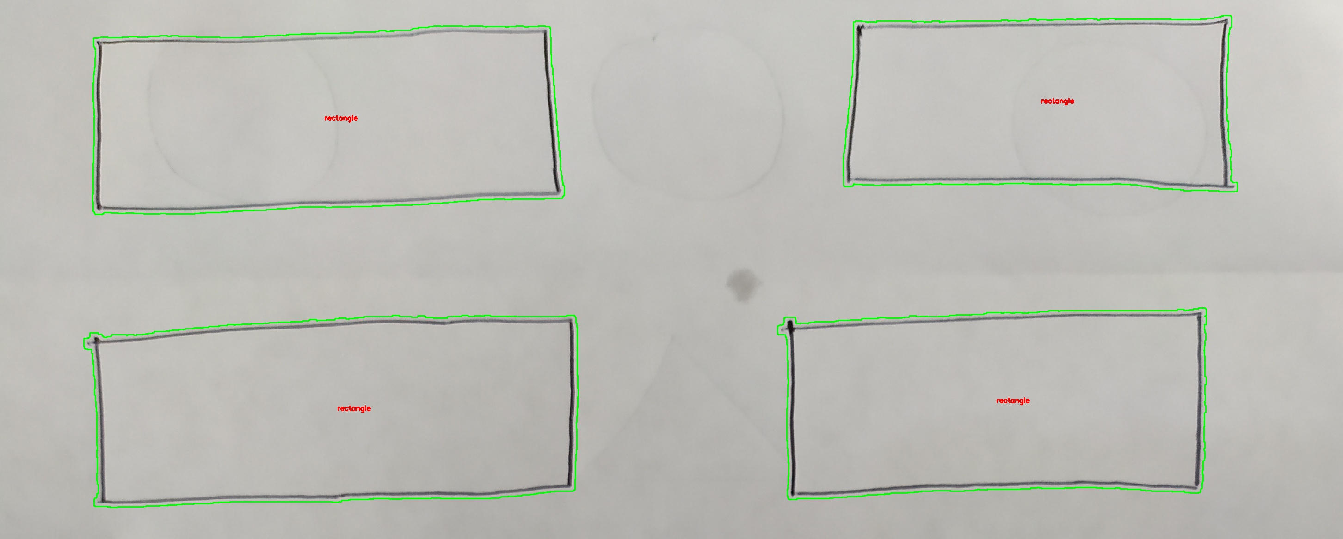
FLOW OF EVENTS
ORIGINAL IMAGE
DILATED IMAGE
LABELED IMAGE

Slide 5
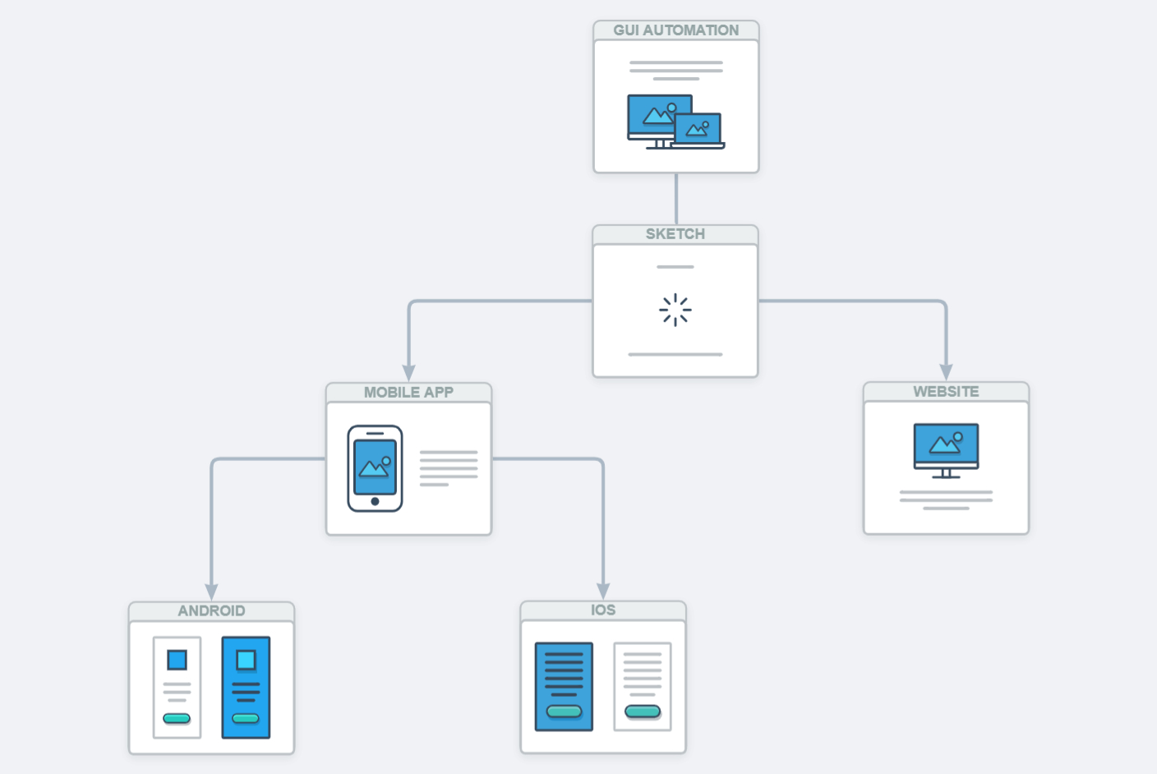
USER FLOWS EVENTS

Slide 6

IMPACT
The idea of this project is to sketch a User Interface on a piece of paper/ or a doodle which can converts the image into an actual skeletal product.
The outcome/ product could be a React Native App or a Website.
When made, this could be a learning app for teenagers/ kids where they sketch a website using a doodle element or draw it on a piece of paper.

Slide 7
RISKS
Considering the edge detection method, it could be a tidious task if we draw with a doodle element where the sketch could slightly change the polygons.
To render the application on React Native platform, we need to save the results/ outcome in an api call to save progress.
Without knowing instructions to sketching, would confuse the users, and they might end up making an incorrect version of their design
To over come this issue, we can ask the user to drag and drop shapes from the toolbar, to approximate the shapes.
We need to have a temporary database, and the ideal solution would be using noSQL database.
We can make an instruction manual in a separate page on the website.

Slide 8
Target Customers and Users
Entry Level Programmers, Software developers.
UI/UX designers, Bloggers or a person with no coding background.

Slide 9
Similar Products
1. Fronty (https://fronty.com/)
Flow:
Users uploads fully designed website photoshop image to the website -> The app converts the image to HTML website -> users gets the facility to change the content on the website before uploading online -> If users is satisfied then he publishes his website.
Difference:
A. We have a manual of shapes that are associated with code, so user need not need a high photoshop image made by a professional UI/UX developer.
B. We have 2 options to choose from for the final code either website or the mobile application UI.

Slide 10
Similar Products Continue
2. Sketch-code (https://github.com/ashnkumar/sketch-code)
Flow:
First, the app scans the images saved manually by the user -> It uses AI model to identify the text and shapes in the image -> Once identified those elements are converted to HTML elements like div and button.
Difference:
A. Sketch-code’s app is still in research phase and doesn’t give market useable product / fully developed website code.
B. It uses the AI model which separates every element in the image not just limited to proper shapes but to text and other uneven shapes while we are associating code with the shapes.

Slide 11
TIMELINE
Research
Planning
Analysis
Prototyping
Prepare
Design
Evaluate

Slide 12

REFERENCES
https://hub.packtpub.com/opencv-detecting-edges-lines-shapes/ [Slide 1] [Sept 2015]
https://app.wireflow.co/ [Slide 4]
Brahmbhatt S. (2013). Practical Open CV. Technology In Action.

